Slide 1

Student names: Nawaf Alzahem, Fahad Aldulaigan, Mohammad Abuhaimed, Khalid Abu Alsaud and Khalid Hali
Capstone project: Intelligent Hoover as an IoT solution
Course code: SE-495

Slide 2
Background

Slide 3
Today with the development of wireless sensor network, communication, digital electronics and mechanical systems. (WSN) have become smaller in size and lower in cost and more powerful. Besides, it’s coming more multifunctional and can communicate with each other in short and medium distances for environment sensing, data processing in the vacuum robot to serve the implementation.

Slide 4
Project statement : Our aim is to implement an IoT solution that would be compatible with the hoover offering several automated features. The hoover will be roaming around the campus with a screen mounted in it. This would be great for staff and students to experience and an interesting addition to the college campus.
Notes:
We will design and deploy Wireless sensor network for monitoring and controlling voice and facial recognition of the user. In addition, Noise-level sensor in the food court to measure the peak hours of the crowded area. Scale the environmental conditions such as temperature, humidity and gases using an SDK provided by libelium that includes Waspmote , Waspmote Gateway(Access point) and Meshlium.

Slide 5
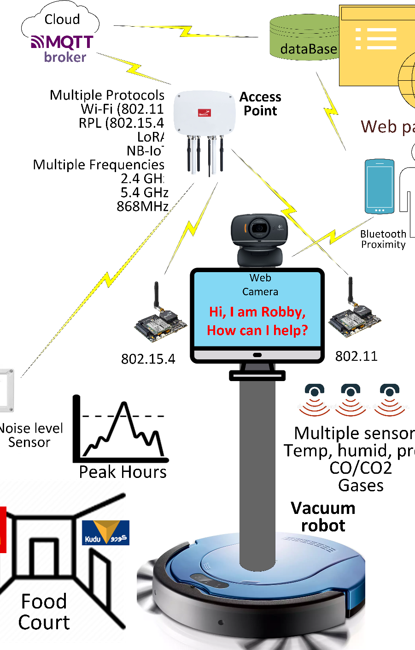
Overview: The system being considered to be developed is the AI powered Robotic Vacuum cleaners referred as the hoovers of type Irobot create 3 ,which are the autonomous devices which are being used worldwide. The new system being developed would be the automated robotic hoover which would be significantly effective and easy in using. The AI powered Robotic vacuum cleaners would include the functionalities of biometrical recognition features which would allow facial or even voice recognition abilities.

Slide 6
Objectives:
1- getting the system to recognize facial features.
2- getting the system to recognize voice features.
3-notification of the crowded area in the food court by using Noise-Level sensor.
4-measure the environmental attributes of the Gases, humidity and temperature.

Slide 7
Project approach:
The software development life cycle must be followed on agile method to tend on the development of the technical work that includes Waspmote IDE and developing a solid SRS and SDD to be followed with an overlapping process to build a fully functional intelligent hoover . And yet another updates TBD on RO2 and raspberry pi OS to be installed on our purchased iRobot create 3 to program it and develop it based on certain metrics and parameters that is customized. We will design and deploy Wireless sensor network for monitoring and controlling voice and facial recognition of the user. In addition, Noise-level sensor in the food court to measure the peak hours of the crowded area. Scale the environmental conditions such as temperature, humidity and gases using an SDK provided by libelium that includes Waspmote , Waspmote Gateway(Access point) and Meshlium.

Slide 8
Software Diagrams

Slide 9
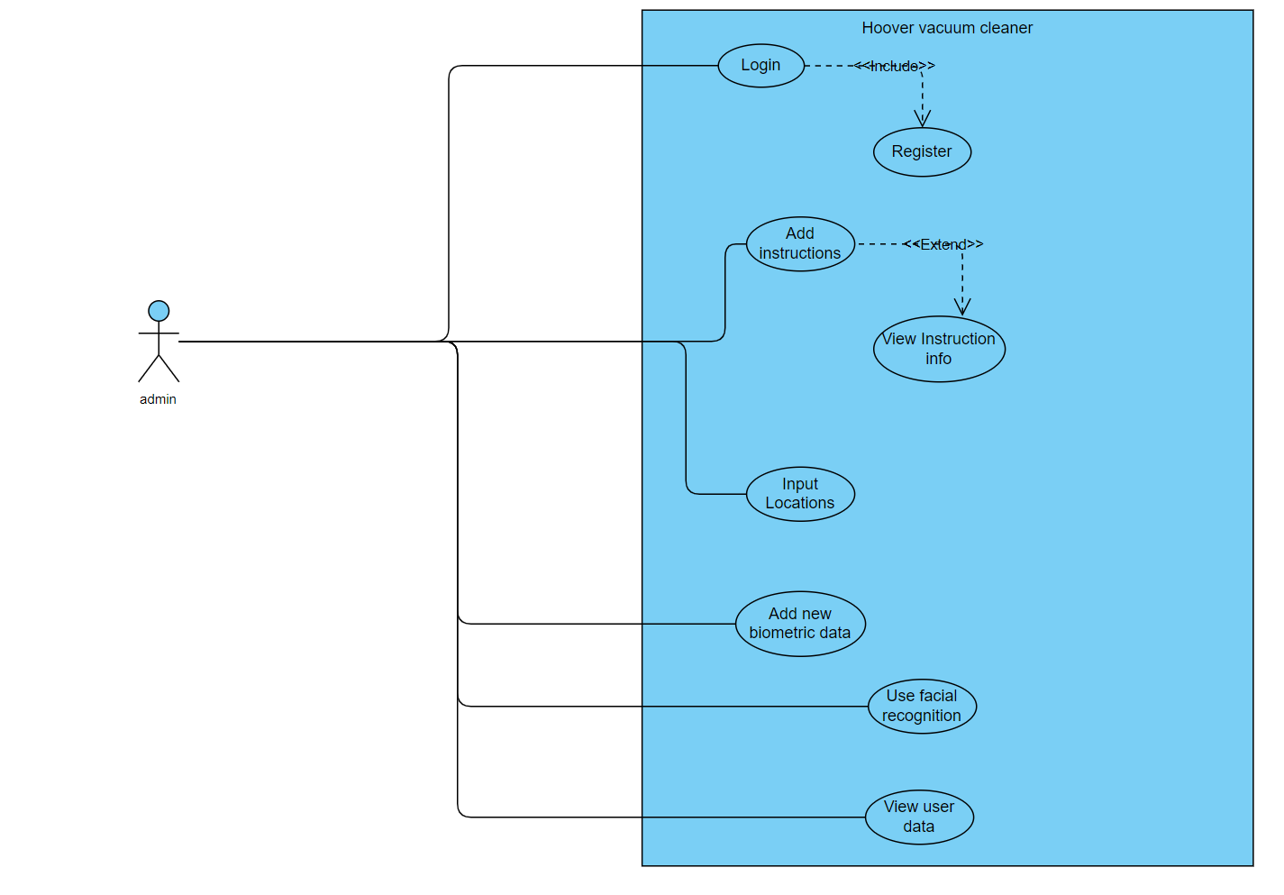
Use Cases for an Admin

Slide 10
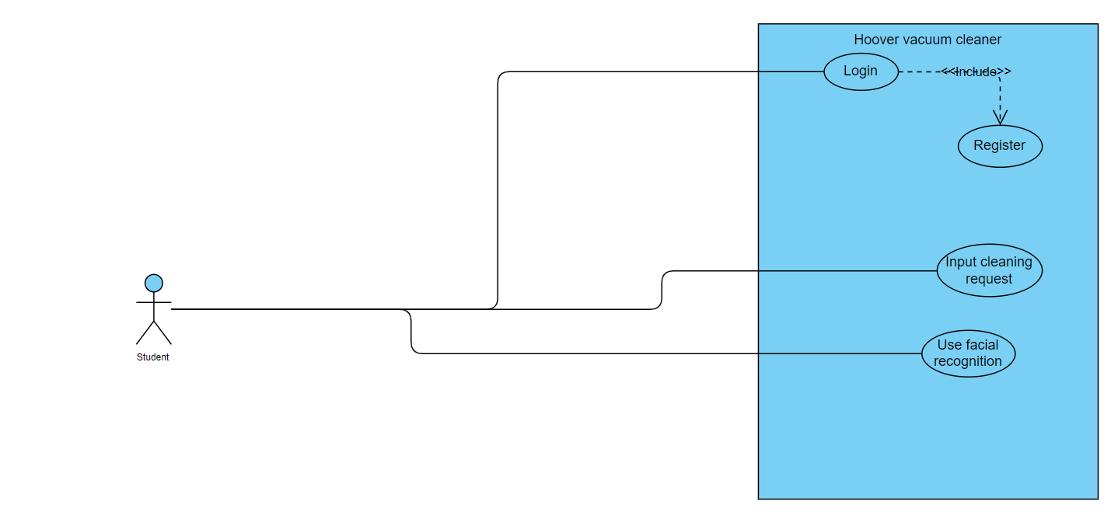
Use Cases for a Student

Slide 11
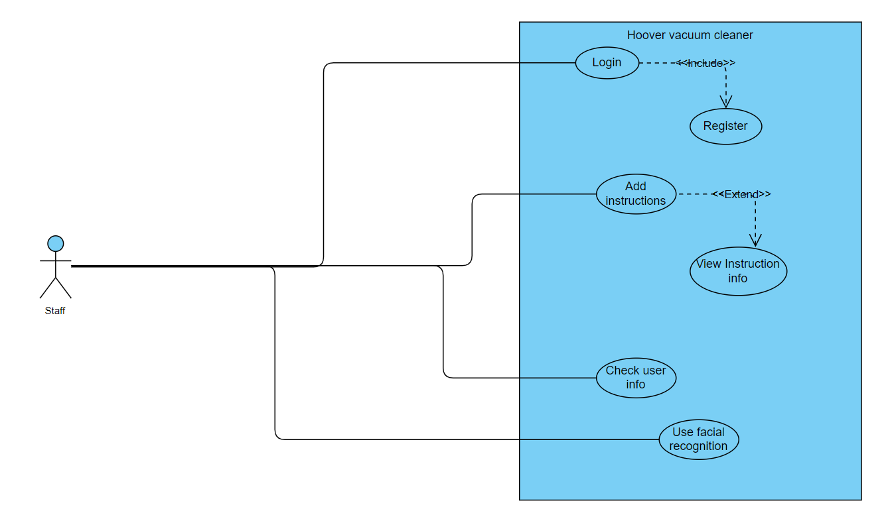
Use Cases for a Staff

Slide 12
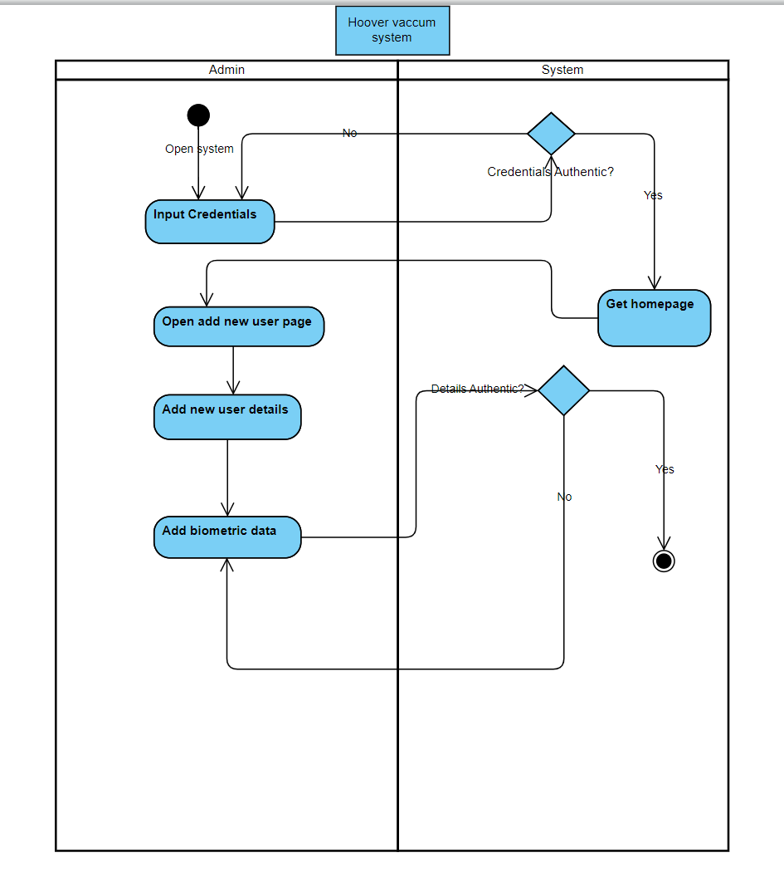
Activity Diagram of the hoover Vacuum system

Slide 13
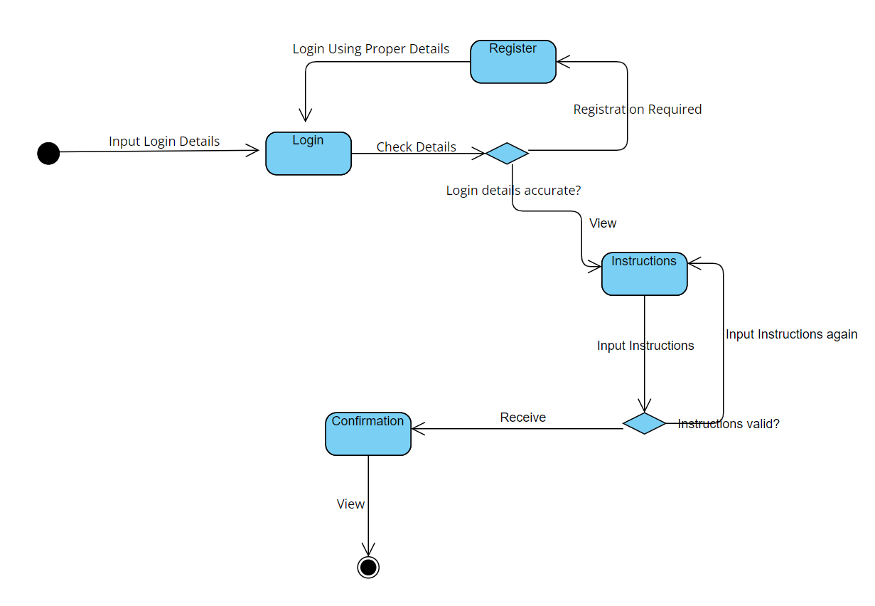
State diagram of the hoover Vacuum system

Slide 14
Requirements

Slide 15
Functional requirements:
Admin: System should allow the admin to access the libelium main page to control the output the hoover.
Admin: System should allow the admin to use facial recognition and voice recognition for checking the services provided and storing it in MySQL database
Admin: System should allow the admin to input and edit the details of new biometric data of the users by entering complete biometric features on the hoover and ensuring it would be accepted.

Slide 16
Functional requirements:
Students: System should allow the students to input their biometric features which are voice and facial recognition, so the user can access it automatically in the future.
Students : System should allow the students to check their biometric features in the database for existence.
Staff: System should allow staff to check all user request and inputs to keep control of the system and accept the tasks.

Slide 17
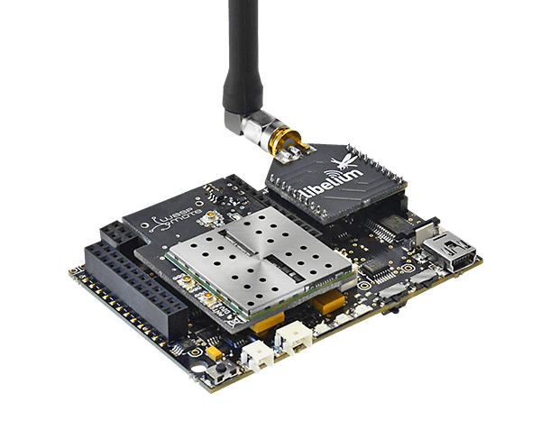
Functional requirements:
Waspmote: wireless sensor node to collect environmental data with the help of corresponding sensors including temperature sensor ,humidity sensor and pressure sensor store the data in its flash memory or SD card and use a XBee ZigBee Pro module or a XBee 868 module to transmit the data to a Waspmote Gateway or a Meshlium. To realize the communication purpose, considering the wireless sensor network is influenced by many factors, many different Waspmote modules need to be programmed and tested independently.

Slide 18
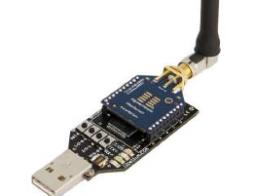
Functional requirements:
Waspmote Gateway: As a data bridge and Access Point (AP) between sensor network and receiving equipment, the Waspmote Gateway is used for collecting data that flows from the wireless sensor network into a PC or other devices equipped with a standard USB port. The Waspmote Gateway is responsible for receiving data and using depending on the specific needs of the application. The Waspmote Gateway equipped with the XBee ZigBee Pro module as shown

Slide 19
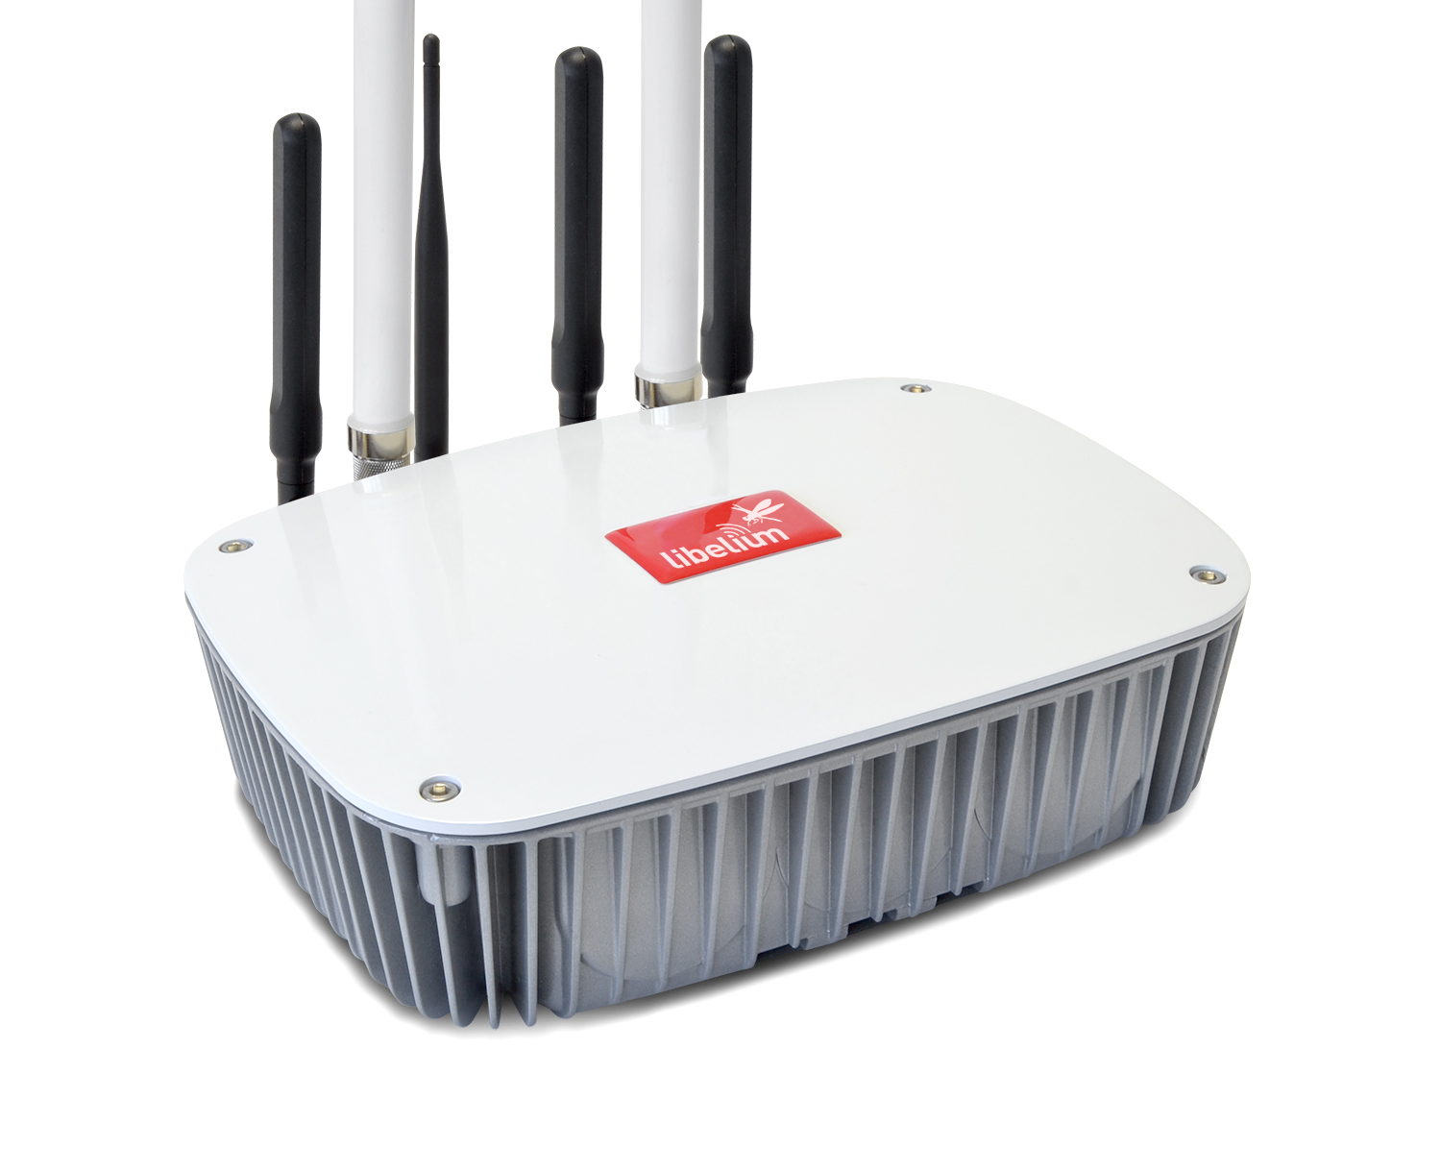
Functional requirements:
Meshlium : is able to be placed outside. Libelium provides a Manager System that works as a web application for developers to control Meshlium quickly and easily. The Manager System provides graphical configurations of WIFI, ZigBee, Bluetooth and 3G/GPRS module and storage options of sensor and received data. The Meshlium equipped with two WIFI antennas and two ZigBee antennas. As a coordinator receiving the collected environmental parameters, Meshlium is used in communication with Waspmote equipped with the XBee ZigBee Pro module. In the Manager System, Meshlium can be settled to save the collected data in local files, local base, or even external database with a specific address and a port on Internet.

Slide 20
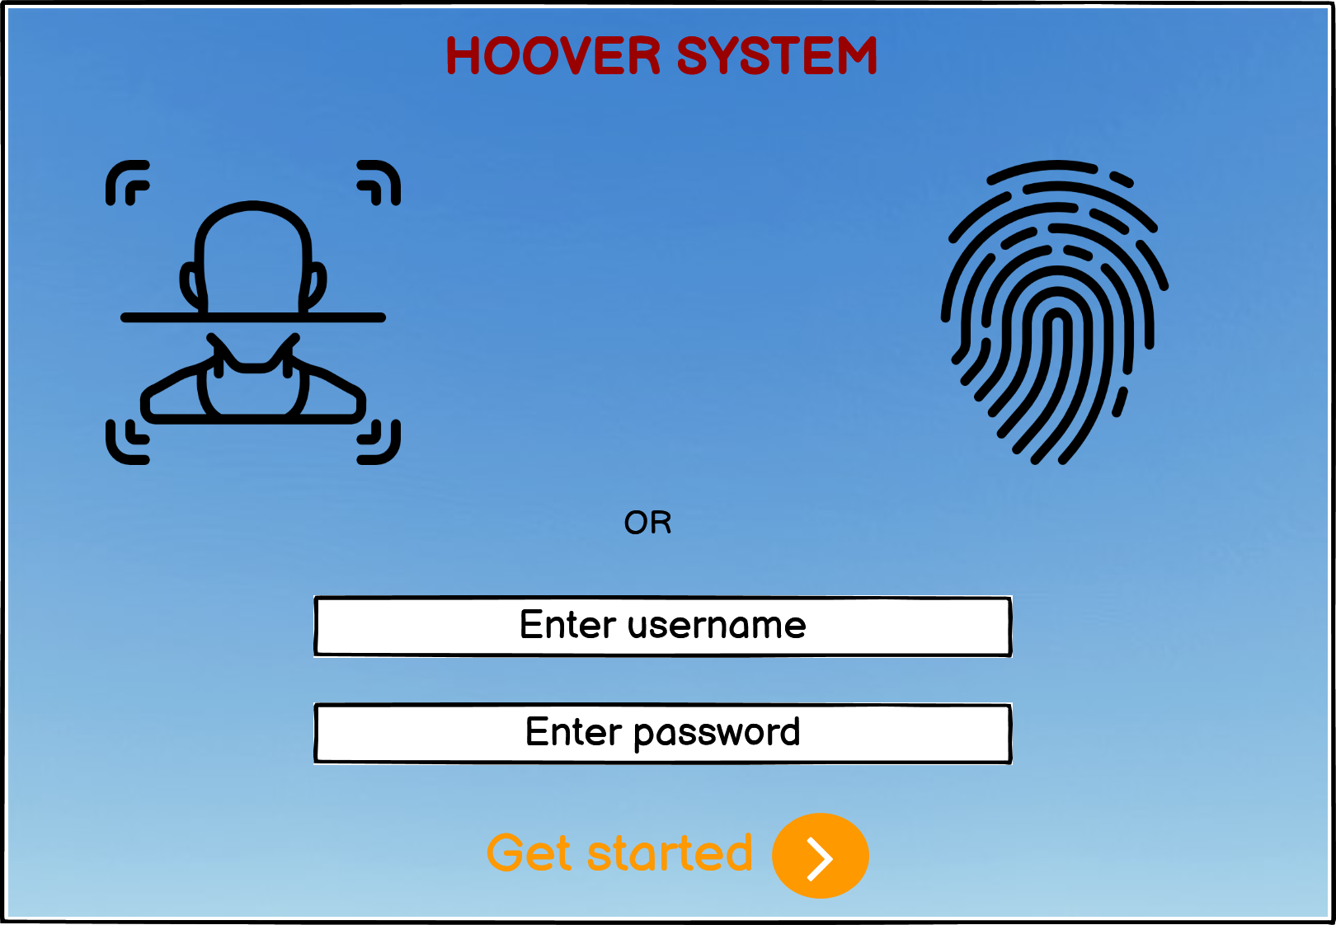
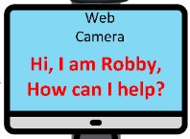
Non-Functional requirements
User Interface: hoover should include simple elements and features which could easily be used by vast range of users. The system should allow alternate languages for ensuring all types of users would be able to access the features easily.

Slide 21

Non-Functional requirements
Logbook: system should have the ability of documenting and logging all the activities being requested from the hoover which would be helpful for future analytics and gain insights.

Slide 22

Non-Functional requirements
Performance characteristics: The system should take input within approximately 0.2 second from the touch screen and provide appropriate output as needed by the users. The system should provide throughput of taking multiple orders per second. Any incorrect details being entered into the hoover should be easily detected and then error message should be displayed along error resolution techniques.

Slide 23

Non-Functional requirements
Hardware consideration: The hardware being considered for the new hoover device is the webcam on the vacuum screen which could be used by the users for providing the instructions and make the hoover work easily.

Slide 24
Non-Functional requirements
System interface: The system would take input through voice recognition, facial recognition as well as user input through the webcam screen on the hoover. The system would also take input from the app connected with the hoover which would provide the users with improved method of providing the input.

Slide 25
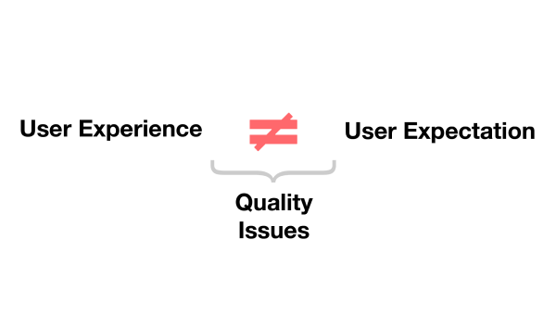
Non-Functional requirements
Quality issues: The interface of the hoover should be developed with proper materials for ensuring any kind of input would be accepted by the users. The voice recognition should match the voice of the pre-defined users and only take input from these users.

Slide 26

Non-Functional requirements
System modifications: The system should allow modifications in the overall underlying interface of the hoover as well as the facial or voice recognition data being entered into the system. The system should provide the ability of providing additional input of the users who could be accessing the hoover through facial recognition.

Slide 27

Non-Functional requirements
Physical environment : The hoover would work in any condition of the rooms around the college campus. The system would allow the users to make the hoover travel to any distance

Slide 28
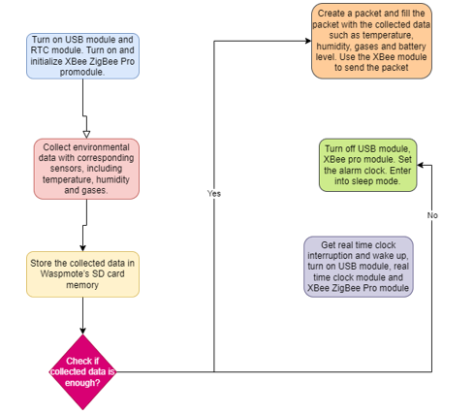
Design key program flowchart

Slide 29
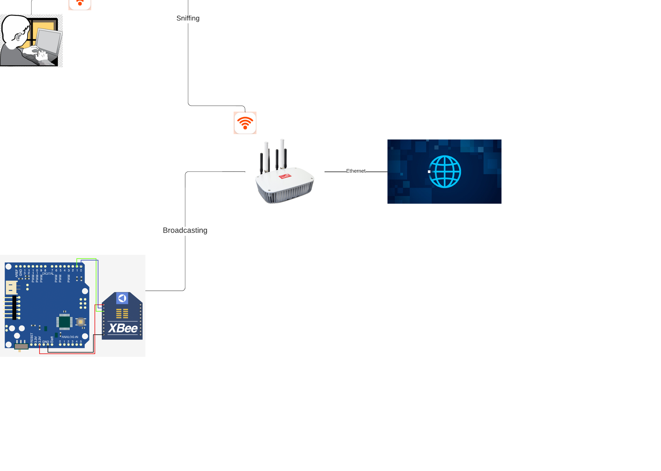
Design of Meshlium

Slide 30
Advantage of strategy
Libelium Cloud enables users to fully manage all devices, connectivity and data across all IoT projects on a single remote platform, generating both significant operational and cost advantages.

Slide 31
Limitation of strategy
The number of sensors nodes in network can be in several order of magnitude higher than nodes in ad hoc network because they are broadcasting information to the Meshlium access point.
Sensor nodes are prone to failures, because they are densely deployed.
Sensor nodes are limited in power, computation capacities, and memory.

Slide 32
Sensor network applications
Sensor network applications can be used for continues sensing event detection of MAC protocol or NET ADDRESS local control of actuators applied for triple sensors that measure humidity which is given in as g.m-3, which is units of grams of water vapour per cubic metre of air. , temperature in Celsius ,pressure in Pa and Noise-level sensor hertz.

Slide 33
Key interfaces of the system
all programs are edited, compiled and uploaded using the IDE provided by libelium. The waspmote will be used in raspberry pi waspmote board. Besides compiling and uploading functions, the serial monitor is the part that runs your waspmote board using your LAST CMD on the menu TOOLS by monitoring and running data parameters through the USB module connected to the computer or laptop to check the status of the code.

Slide 34
Goal of the system
The goal of the system is to design and deploy a wireless sensor network for monitoring results on labelium waspmote that works with sensor device equipped with different specific modules for this project. We must monitor the data of Meshlium in real time and extract the parameters using manager system of Meshlium. Waspmote stores the data in SD card and uses wireless communication module to transmit the collected data in MySQL database or local database of Meshlium manager system through the internet.

Slide 35
Conclusion: With the development of wireless sensor network applied in many aspects of day-to-day life. We could monitor the environmental parameters and receive the gathered data in real time from remote places. The libelium components help us uses corresponding sensors to collect data and use communication modules. Furthermore, it can be extended that modules could be utilized to send data to the camera for visual monitoring.

Slide 36

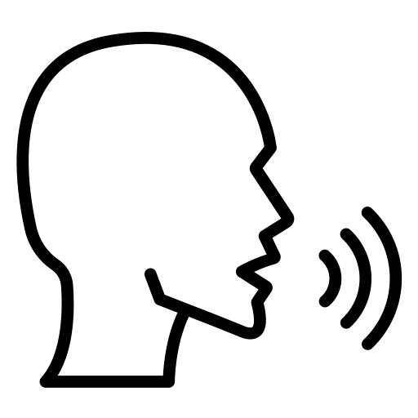


Admin logs in using facial recognition biometric then allowing inputting the locations to be cleaned around the campus. Checking the database provided around the campus.
The allowance of using voice recognition identified by the person giving the cleaning instructions.
The capability to add new biometric data features of the users in the system. Editing the biometric features details of any of the users and ensuring it would be accepted

